Slide 1





Charles Warhurst: Programmable DC Electronic Load Update

Slide 2
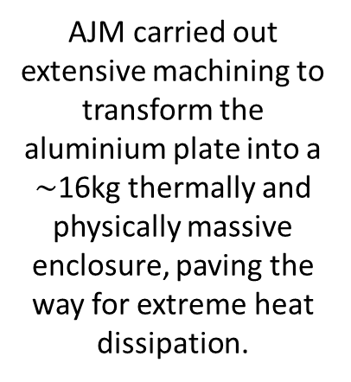
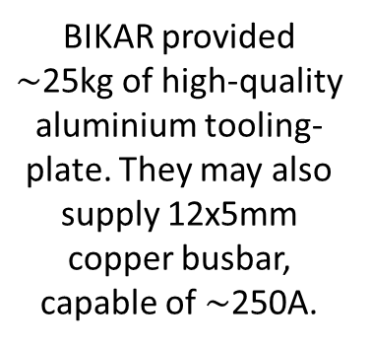
Industry Support & Contributions
BIKAR provided $\sim$25kg of high-quality aluminium tooling-plate. They may also supply 12x5mm copper busbar, capable of $\sim$250A.
AJM carried out extensive machining to transform the aluminium plate into a $\sim$16kg thermally and physically massive enclosure, paving the way for extreme heat dissipation.
Hymec has agreed to anodize the aluminium plates, giving them a protective coating. Conveniently located in Plymouth, anodizing ensures long term durability.
Riedon provided their SSA2-250A smart current sensor, capable of measuring up to 500A with reinforced isolation

Slide 3
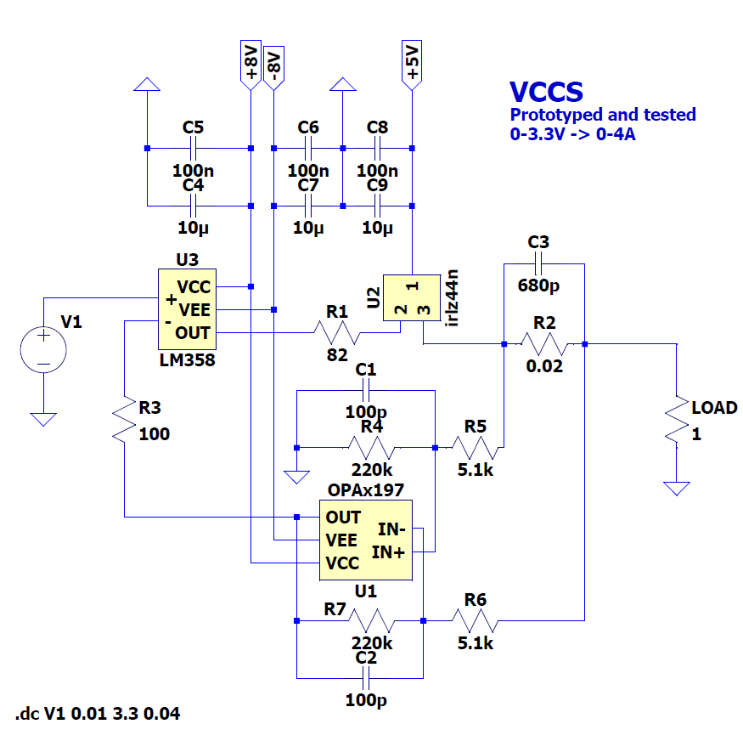
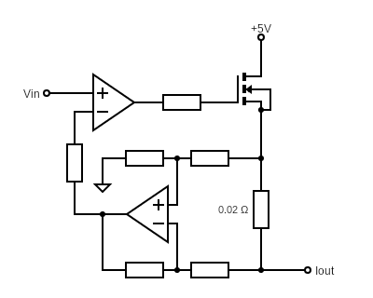
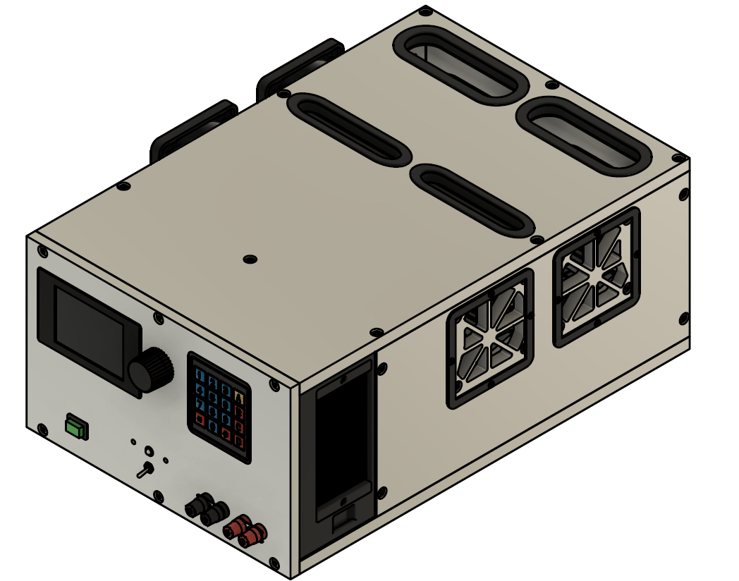
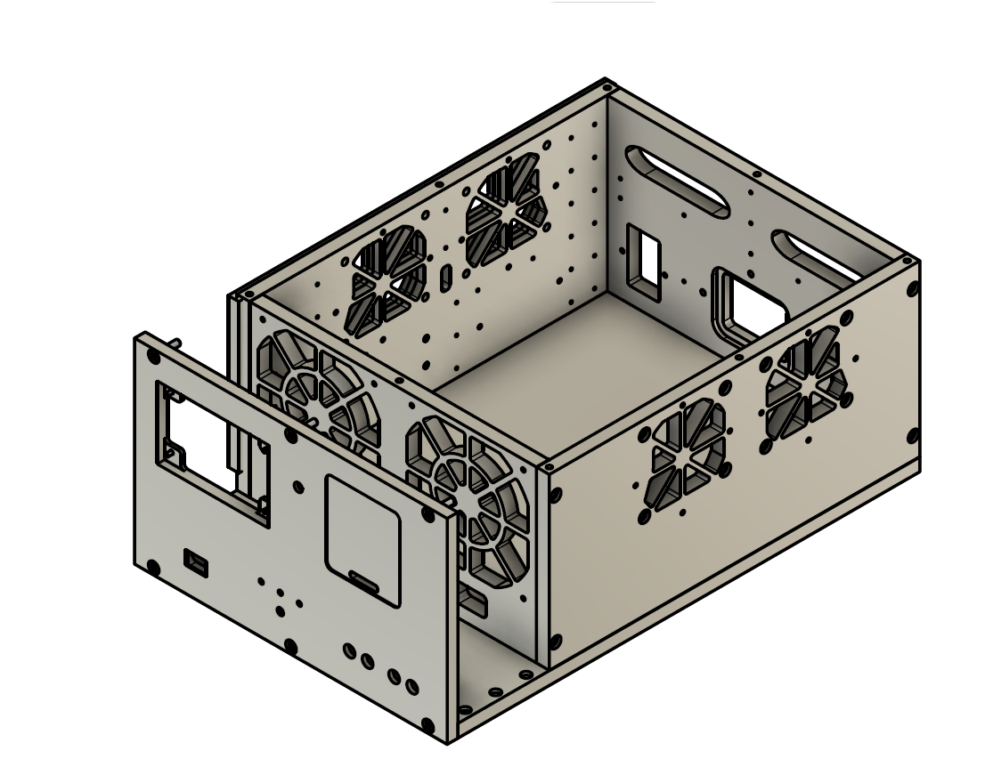
First Deliverable:
Functional constant current mode operation with basic manual control. Completion of initial enclosure design.

Slide 4
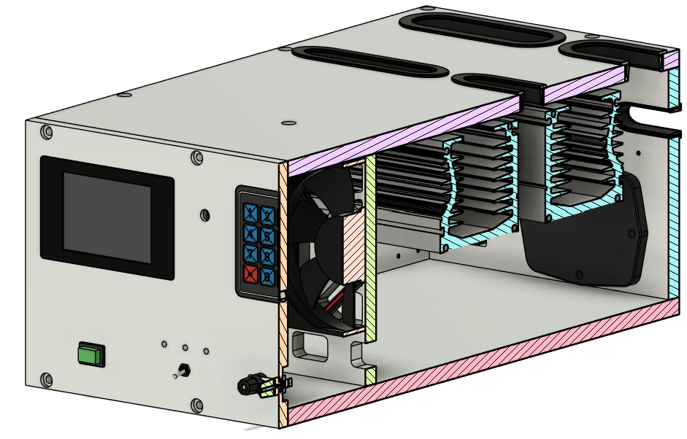
First Deliverable:
Functional constant current mode operation with basic manual control. Completion of initial enclosure design.
The VCCS circuit (0-3.3V -> 0-4A) has been prototyped on perfboard and is working better than expected, fully meeting this part of the deliverable. It uses an OPA197 differential amplifier for precise current sensing and an LM358-based control loop to regulate the MOSFET gate drive. This circuit will be one of the end effectors in the final control system, enabling accurate current control of the MJ15024 power transistors. Initial testing confirms fast response, minimal oscillation, and high repeatability, ensuring a solid foundation for the next development stages.
The enclosure design is complete, fully meeting this part of the deliverable. The 16kg machined aluminium structure is designed for both thermal performance and mechanical stability, integrating seamlessly with the cooling system. It features three independent airflow channels, multiple fans, and carefully placed intake and exhaust vents to optimize heat dissipation. The design process was extensive, requiring precise CAD modelling of every mounting fixture, hole, and thread to ensure a flawless final build. With machining now in progress at AJM Engineering, the enclosure will be in hand within days.

